Slide 1


HITROLINK Smart Conference Assistant Product Introduction

Slide 2
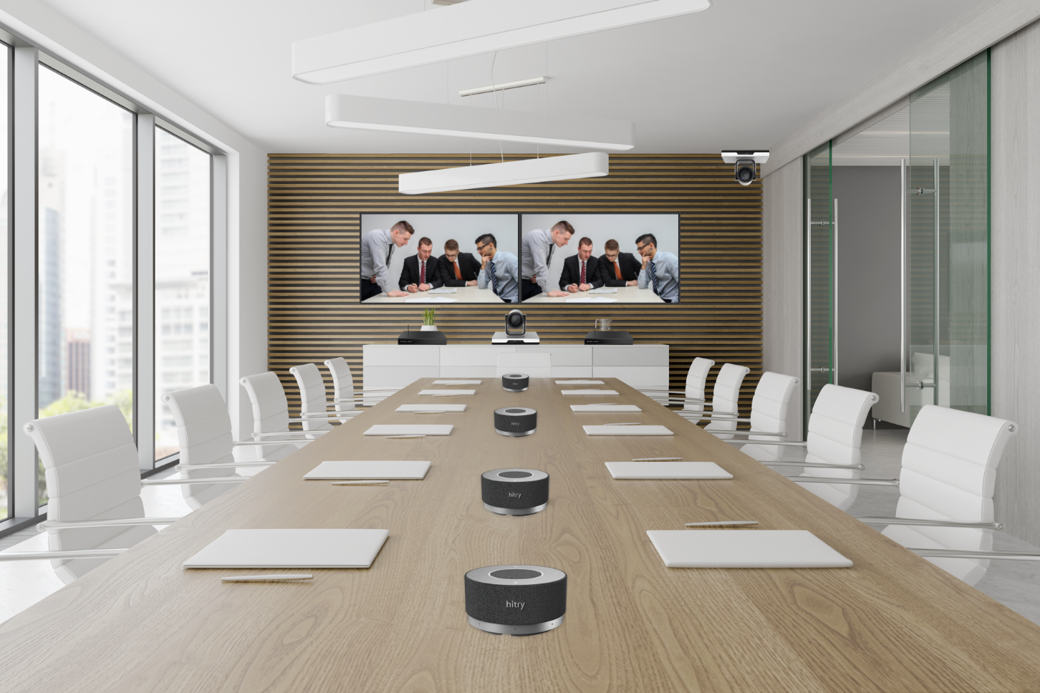
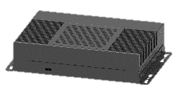
Split smart conference assistant: lightweight + data security
The split-type intelligent conference assistant integrates microphone array technology, intelligent audio 3A algorithm, sound source localization algorithm, voiceprint recognition algorithm, intelligent noise reduction model, ASR model (speech to text), NLP model (natural language processing) and other technologies to realize functions such as speaker recognition, real-time speech transcription, offline voice file transcription, and meeting minutes summary. It is suitable for local meetings and remote voice / video conference scenarios, and focuses on lightweight and data security.
Local conference networking mode : The microphone collects local sound and transmits it to the smart box via a USB cable to achieve audio data transmission. The smart box realizes voice transcription and meeting minutes generation, and the transcription results are obtained through the local
Remote conference networking mode : The microphone is connected to the video conferencing terminal via a USB cable. The microphone transmits the locally collected sound and the remotely played sound to the smart box via the network cable. The smart box realizes voice transcription and meeting minutes generation, and the transcription results are obtained through the local
Microphone Speaker
Smart Box

Slide 3
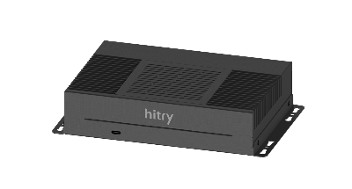
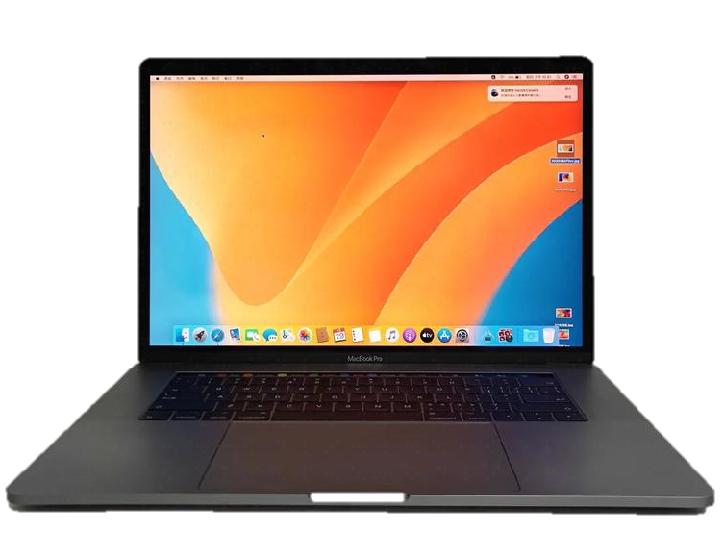
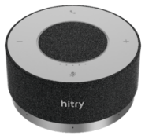
Split - Universal Local Conference Networking Mode 1
Solution topology
network
USB
PC Management Terminal
Split smart conference assistant
AI pickup microphone (expandable cascade 3 levels)
Solution Introduction:
Front-end sound pickup equipment : Huachuang clear sound algorithm AI sound pickup microphone, which has AI noise reduction, AI echo cancellation, AI de-reverberation and sound source positioning functions. It also has an 8-microphone array and supports 4-level microphone cascading to ensure clear venue sound reception and wide coverage.
Data processing equipment : Split-type intelligent conference assistant, which can transcribe the conference audio content in real time, intelligently summarize it, distinguish speakers through voiceprint + positioning, etc., and also supports instant export of conference audio and meeting minutes files.
Display device : This solution uses a B/S architecture. Customers can use a personal computer or HDMI display to view the transcribed content at any time and download and save relevant meeting files.

Slide 4
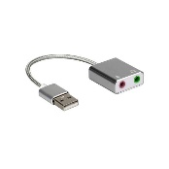
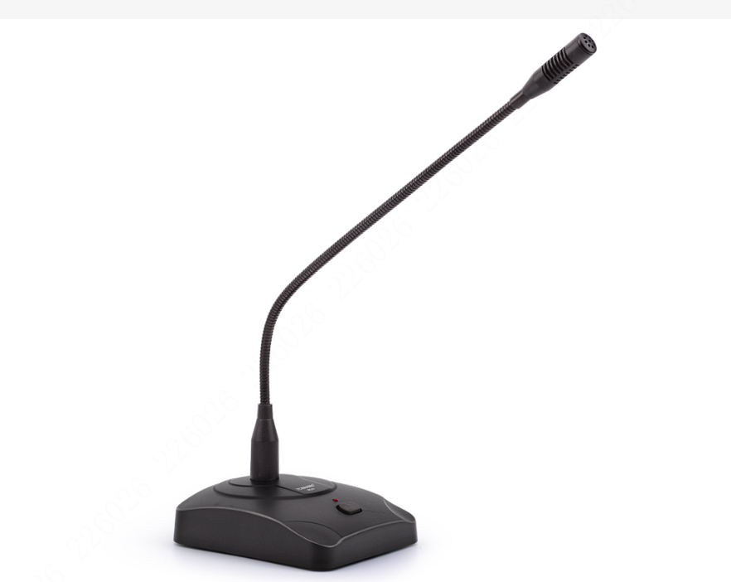
Split - Universal Local Conference Networking Mode 2
3.5mm audio cable
Solution topology
Solution topology
3.5mm audio cable
network
USB
3.5mm audio cable
PC Management Terminal
Split smart conference assistant
3.5mm audio cable
Solution Introduction:
Front-end pickup device : Directional gooseneck microphone
Data processing equipment : Split-type intelligent conference assistant, which can transcribe conference audio content in real time, accurately distinguish speaker content through physical means, and provide intelligent summaries, etc. It also supports instant export of conference audio and meeting minutes files.
Display device : This solution uses a B/S architecture. Customers can use a personal computer or HDMI display to view the transcribed content at any time and download and save relevant meeting files.

Slide 5
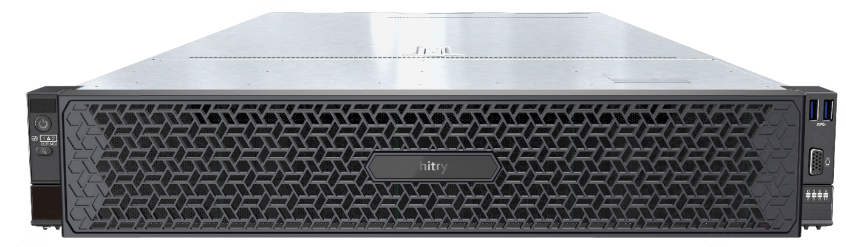
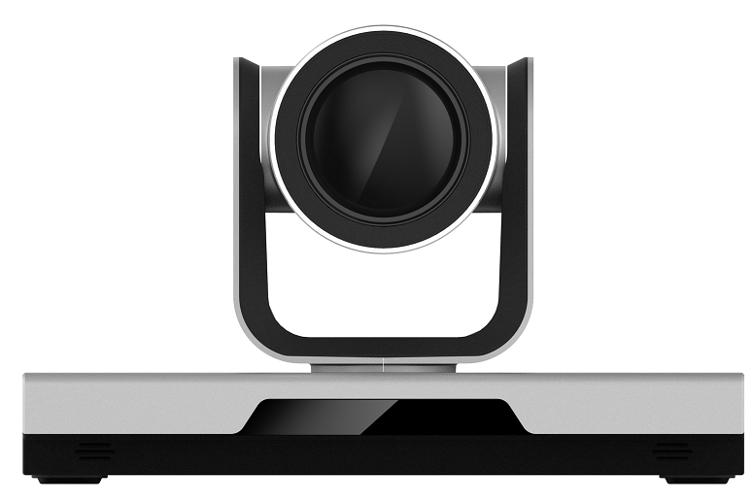
Split - Universal Remote Conference Networking Mode 1
Split smart conference assistant
Conference Server
Solution topology
network
PC Management Terminal
Local + Remote
network
USB
AI pickup microphone
Conference Terminal
Conference Terminal
Solution Introduction:
Front-end sound pickup equipment : Huachuang clear sound algorithm AI sound pickup microphone, which has AI noise reduction, AI echo cancellation, AI de-reverberation and sound source positioning functions. It also has an 8-microphone array to ensure clear sound reception and wide coverage in the venue.
Data processing equipment : Split-type intelligent conference assistant, which can transcribe the conference audio content (local + remote audio stream) transmitted by AI pickup equipment through the network in real time, distinguish speakers through voiceprint + positioning, and perform intelligent summary, etc. It also supports instant export of conference audio and meeting minutes files.
Display device : This solution uses a B/S architecture. Customers can use a personal computer or HDMI display to view the transcribed content at any time and download and save relevant meeting files.

Slide 6
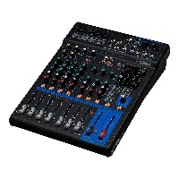
Split - Universal Remote Conference Networking Mode 2
AI Intelligent Transcription Microserver
USB Sound Card
Mixer
Conference Server
remote
Audio out
local
network
Audio in
PC Management Terminal
Hand in Hand Gooseneck Wheat
Conference Terminal
Conference Terminal
Solution Introduction:
Front-end sound pickup device : local audio is output through the directional gooseneck microphone and the mixer AUX , and remote audio is output through the conference terminal audio output port to the mixer AUX
Data processing equipment : Split-type intelligent conference assistant, which can transcribe the conference audio content transmitted from the mixing console (local + remote audio stream) in real time, distinguish speakers through voiceprint + physical method, intelligent summary, etc., and also supports instant export of conference audio and meeting minutes files.
Display device : This solution uses a B/S architecture. Customers can use a personal computer or HDMI display to view the transcribed content at any time and download and save relevant meeting files.

Slide 7
Intelligent Meeting Assistant Features
Easy-to-use human-computer interaction
Real-time voice transcription
Speaker Identification
Realize real-time transcription of local conference voice and remote conference voice, and automatically separate sentences and segments during transcription
Supports speaker differentiation based on " sound source positioning + voiceprint recognition " , and differentiates speaker display for transcribed content; supports voiceprint management, pre-recording personal voice information, extracting voice features, and automatic matching of speaker information
Offline file transcription
Smart Meeting Assistant
Far-field clear sound pickup
Support importing recording files to quickly transcribe offline voice files
Built-in microphone array intelligent algorithm, a single microphone supports 8 meters of sound pickup; supports 8 microphones cascaded to expand the sound pickup and amplification area; supports intelligent noise reduction; supports sound source positioning
Meeting minutes generation
Data security management
Automatically generate meeting minutes based on the transcribed content and the meeting minutes template
Open compatibility for easy integration
Local storage of recording files, transcriptions and meeting minutes data; users use their account and password to log in and view data, and permissions are isolated between accounts;

Slide 8
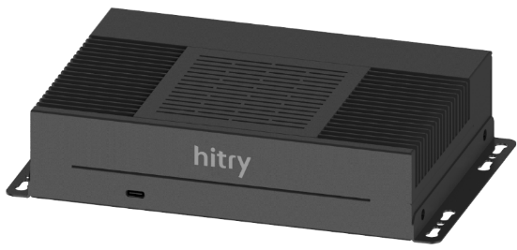
 | Parameter name | Parameter Value
Master | CPU | Integrated high-performance domestically produced eight-core ARM A53, with a main frequency of up to 2.3GHz
 | TPU | Built-in tensor computing module TPU computing power up to: 32TOPS (INT8), 16TFLOPS
Memory | Memory | 16 GB
storage | storage | 64GB
network | Ethernet | 1000Mbps Ethernet × 2
 | Wireless network | 2.4GHz/5GHz dual-band WiFi, 802.11a/b/g/n/ac
video | Video Output | HDMI (1080p@30fps) × 1
Connection | Hotspot connection | Support hotspot connection login
 | Wired connection | Support wired network connection login
Real-time voice recording | Support real-time speech to text conversion | Support local microphone recording transcription
 | Support real-time transcription of remote conferences | Support video conference audio transcription
 | Supports automatic sentence and segmentation | During the transcription process, automatic segmentation and sentence division are supported
Transcription performance | Real-time speech transcription | 4-channel USB audio input
 | Mandarin transcription accuracy | >97%
 | Offline audio file transcription | 1 hour audio file, transcribed within 10 minutes
 | Meeting minutes summary generation | 1 hour meeting, automatically generate meeting minutes within 5 minutes
Configuration Management | Hot words | Support adding hot words to improve transcription rate
 | Voiceprint Management | Support voiceprint pre-recording
Meeting record management | Support editing and modifying meeting records | Support modification and editing of text content after the meeting
 | File Management | Support downloading and deleting meeting files (audio files, transcriptions, meeting minutes)
 | Listen back with phonetic and character comparison | Supports audio and text comparison and review. Click on the text to quickly locate the corresponding audio
Operations | Log Export | Support log export to assist in locating problems
 | Version Upgrade | Support WEB upgrade
protocol | protocol | UAC, HTTP protocol
Physical parameters | interface | USB3.0 (current limit 1A) × 2, USB2.0 (current limit 500mA) × 2, TF × 1
 | power supply | DC12V (DC5.5mm×2.5mm)
 | Operating temperature | 0-45℃
 | size | Length × width × height: 210 × 130 × 44.5 (mm)
 | weight | 1.28kg
Split smart conference assistant
Local Conference
videoconference
Voice Conferencing
FeatureS
Split design, flexible deployment and lightweight
Offline transcription, equipped with local large model physical isolation, ensures information security
Voiceprint recognition, automatically distinguishing different speakers
AI conference assistant, automatically summarizes the meeting content and outputs summary
With ASP35 , it supports upgrading traditional conferences to AI conferences

Slide 9
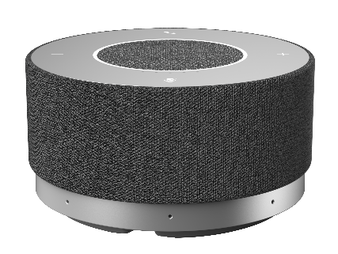
Conference Assistant Microphone Speaker
Dual-mode microphone speaker
Parameter classification | Parameter name | Parameter Value
Function | model | Pure pickup mode & integrated mode
Audio | Number of built-in microphones | 8
 | Microphone noise reduction | support
 | Pickup distance | 8m pickup radius
 | Number of built-in speakers | 1​
 | Built-in speaker specifications | 2W
 | Sampling rate | Sampling rate: 48 khz
 | Frequency Response | Frequency response: 100hz ~ 20khz
 | Sensitivity | Sensitivity: - 35 dBFS
 | Signal-to-Noise Ratio | Signal-to-Noise Ratio: 68 dBA
interface | Input and output interface | USB (terminal) - typec (microphone)
Power supply | Power supply | Power adapter 53 V 1A; USB 5V 1A
Installation | Installation | desktop
Cascading capability | Cascading capability | 8 - level cascade
Physical parameters | Product size | 126mm × 67mm
 | Packing size | 314mm×172mm×89mm
 | Weight ( net weight ) | 514
 | Weight ( gross ) | 1662g
Other Specifications | Cable length | 3m network cable × 1 1.5m power adapter × 1 5m TYPEC -USBA cable × 1
 | Maximum Power | 5W
 | Operating temperature | 0 - 40℃
HT-ASP35
FeatureS
Supports two modes: pure pickup mode, microphone speaker mode
AI intelligent noise reduction, AI echo cancellation, AI de-reverberation
Omnidirectional 8- microphone array
Full-duplex technology
USB Plug and Play
Support 8- level PoE cascading

Slide 10






Thank you
Facebook
Instagram
CONTACT US
15th & 16th Floors, Building 1, Strong Square, No.1168 Bin′ an Road, Binjiang District, Hangzhou, China
Tel: +86-571-87235761
E-mail: overseas@hitry.com
https: //www.hitrolink.com
LinkedIn
Youtube

